Slide 1
the Traveling Salesman Using CUDA

Slide 2
MEMBERS
Team #9
Ahmed Sayed Sayed Madbouly
Ahmed Hany Farouk
Presented to
Dr. Dina Tantawy
Eng. Mohamed Abdellah

Slide 3

Problem Definition

Slide 4
DEFINITION
A classic optimization problem.
Objective: Visit a set of cities exactly once and return to the starting city, minimizing the total travel distance.
Project Goal:
Parallelize the TSP solution using CUDA, leveraging GPU power for efficient computation.

Slide 5
SYSTEM DESIGN

Slide 6
THE PROBLEM SOLUTION
Brute force solution:
Initialization: Initialize variables to track the minimum path weight and store factorial values.
Factorial Calculation: Compute the factorial of numbers up to N to help in generating permutations.
Generate Permutations: Generate all possible permutations of the vertices.
Calculate Path Weights For each permutation: Calculate the total weight of the path that visits vertices in the order of the permutation.
Update Minimum Path: Track the minimum path weight and update if a new lower weight is found.
Return The Output

Slide 7
Final System Design
CPU Tasks:
Load edges list and build the graph.
Calculate factorials up to factorial[N].
Launch CUDA kernel with 1024 threads per block and 15 blocks.
GPU Tasks:
Calculate permutations and their start/end indices.
Compute the distance of each permutation.
Find and store the best path in a global array.
One thread (idx=0) iterates over the array to find the global best path.

Slide 8
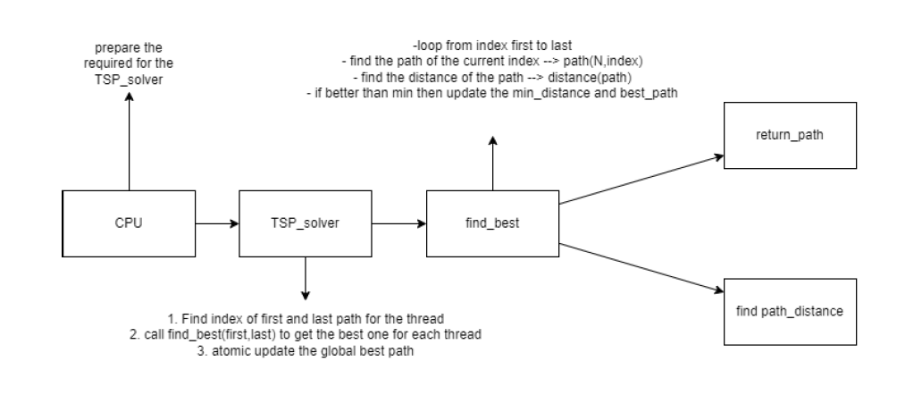

Slide 9

Experimental Results

Slide 10
EXPERIMENTAL RESULTS
Size | CPU Time | GPU Time
5 | 0.105746269226 | 0.7452752590179443
6 | 0.10415220260620117 | 0.5065548419952393
7 | 0.10396766662597656 | 0.5060691833496094
8 | 0.10614156723022461 | 0.5070180892944336
9 | 0.20439553260803223 | 0.5078833103179932
10 | 1.6080279350280762 | 0.6154828071594238
11 | 21.782139539718628 | 0.9082918167114258
12 | 258.97381711006165 | 4.420988321304321
13 | 4363.268090963364 | 57.912707805633545

Slide 11
Speedup Calculation
Number of Cities | Speedup (CPU/GPU)
5 | 0.142
6 | 0.206
7 | 0.206
8 | 0.209
9 | 0.402
10 | 2.613
11 | 23.980
12 | 58.596
13 | 75.3

Slide 12
Theoretical vs. Actual Speedup
Theoretical Speedup:
Ideally proportional to the number of threads (O(n!/p)).
Where p is the total number of threads and n is the number of Cities.
Discrepancies
Kernel launch overhead.
Memory transfer latency.
Thread divergence.
Synchronization overhead.

Slide 13
Streaming
Does streaming increase the performance?

Slide 14
Thank you
Q&A

